Slide 1
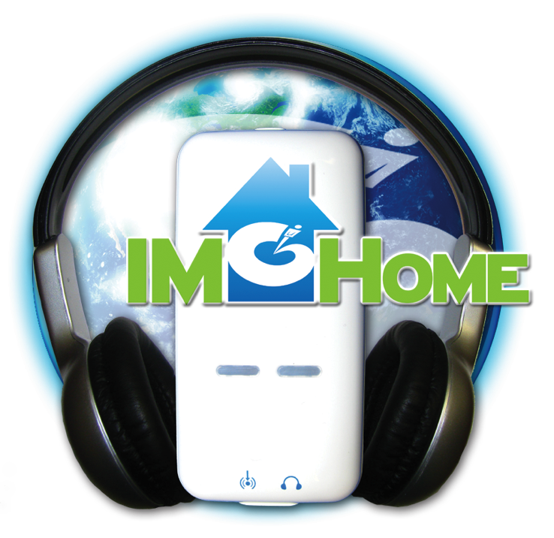
IM-Home
Certification Coaching
Course 1 of 2
Presentation by:
Sherrie Hardy
Hardy Brain Training • Camarillo, CA

Slide 2
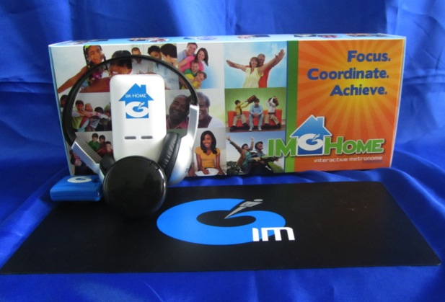
Agenda
Why IM-Home?
What is IM-Home?
Client Selection
Models of use
Your responsibilities as an IM-Home Provider
IM-Home Demo Unit
How to use the eClinic

Slide 3
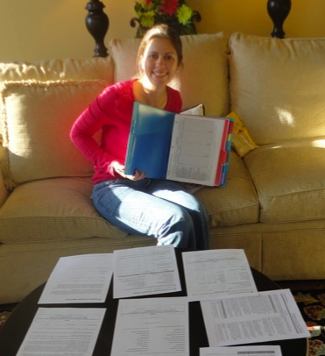
Materials you received
Set-Up & Equipment Guide
Training Templates
eClinic Training Manual
Materials can be downloaded from:
http://imhome.org/index.php/home-certification-coaching

Slide 4
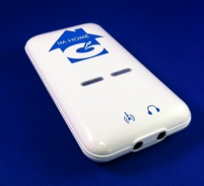

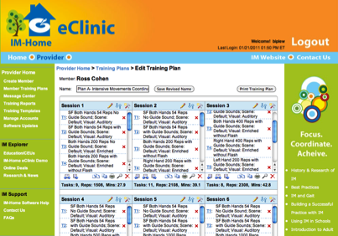
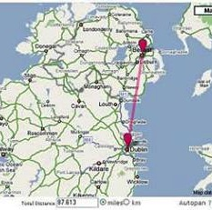

The Problem The Solution
Scheduling
Distance
Money
Limited Clinic Time
Maintenance
Busy Lives/Busy Schedule= IM-Home

Slide 5
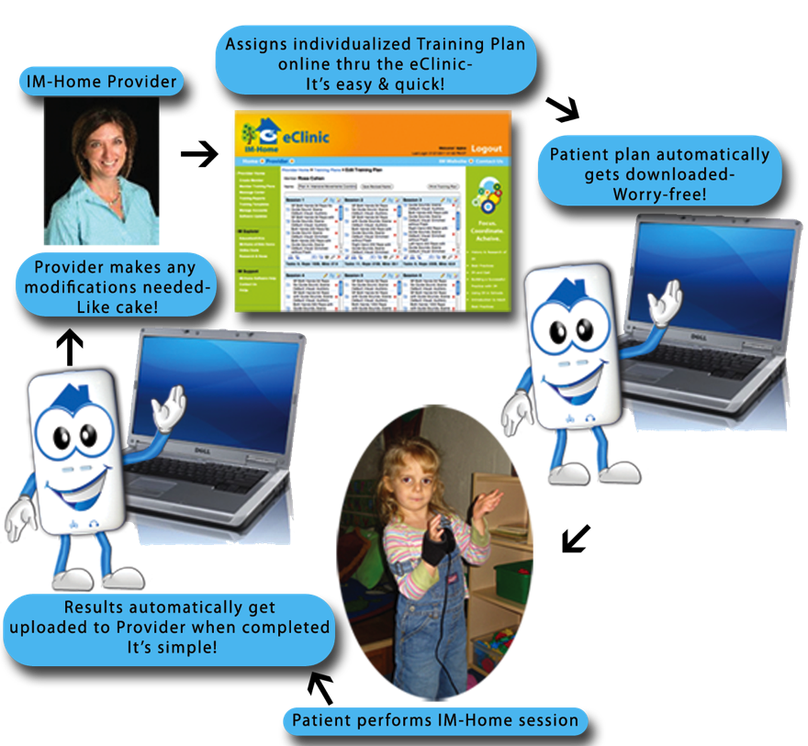
Notes:
What is IM-Home?

Slide 6
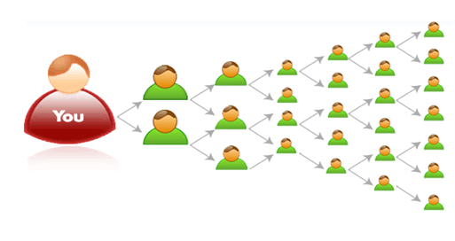
Benefits for the Provider
Grow your business while helping more clients
  Extends Reach
  Builds Volume
  Efficient Therapy Management Tool
  Sets-Up Patients for better overall outcomes

Slide 7

Client Selection
Opportunities
    Travel issues
    High deductibles
    Limited approved visits
    No prescription for OT, PT, ST
    Degenerative Diseases
    Immune Disorders
    Other Opportunities
    Athletes
    Schools
IM-Home IS NOT FOR…Clients who:
Have severe disabilities and need professional guidance
Unable to commit to training 45 min, 5 days a week
Are looking for an instant fix
(ie. Medication)

Slide 8
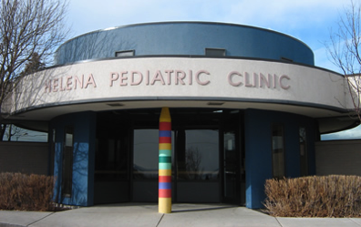
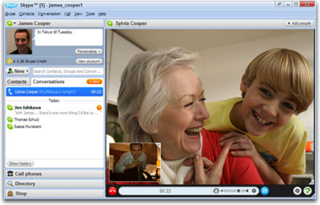
Models of Use
Hybrid
  Mix of In-Clinic & Home allows patient to bill insurance part of the time
Virtual
  Great for those with travel issues or a discharge program
Notes:
Let’s face it. IM was meant to be offered for home use. It’s not a realistic expectation for a family to come to the clinic as much as IM needs to be done.

Slide 9


Your responsibilities as an
IM-Home Provider
Enroll your member in the eClinic
  We will practice on yourself with the demo unit
For users who order through the IM-Home website online, you simple click “accept” in your eClinic account
  Log into eClinic with Provider UN & PW
Set-up training plan

Slide 10
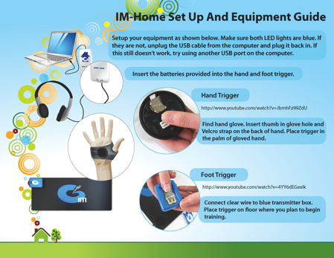
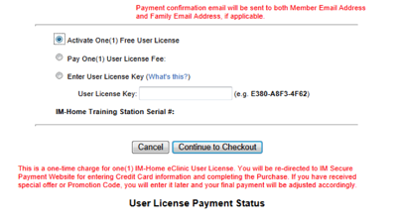
Your responsibilities as an
IM-Home Provider
Explain:
How to set-up the equipment
How to authorize a license

Slide 11
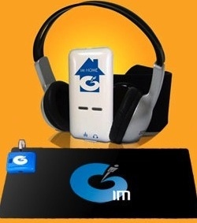
The purpose of your demo unit
Get yourself familiar with the product to support your clients
Use at open houses/ Free Screenings
During in-clinic training clients use their UN & PW on your IM Pro Universe unit while in the clinic, so all training data remains in one file
THIS PRODUCT MAY NOT BE RENTED OUT OR USED AS A CLIENT TRAINING DEVICE OTHER THAN IN YOUR OFFICE WITH A CLIENT WHO ALREADY OWNS THE IM-HOME

Slide 12
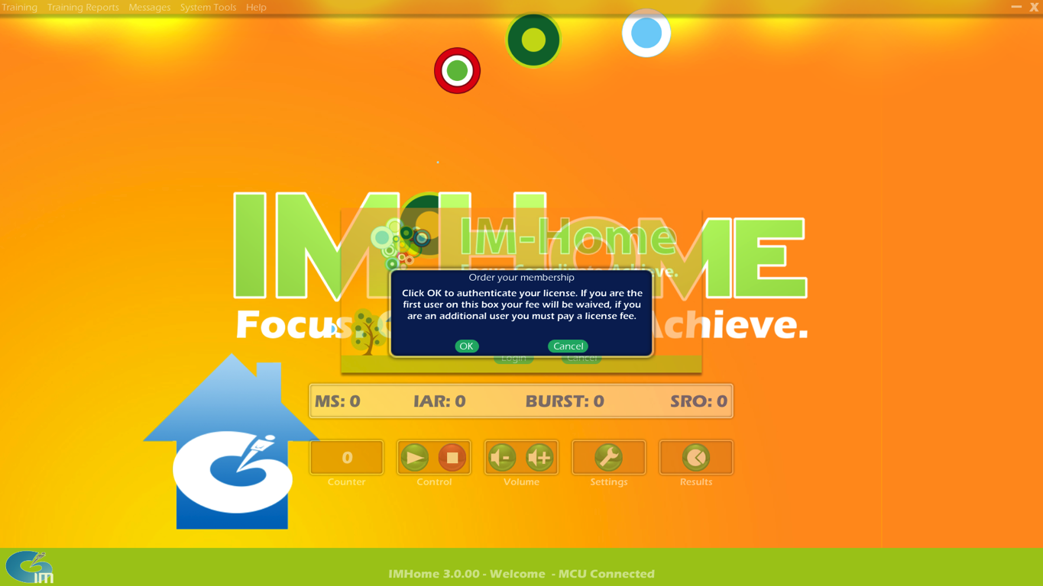
How to authorize your license

Slide 13

Activate One (1) Free User License the Check out

Slide 14
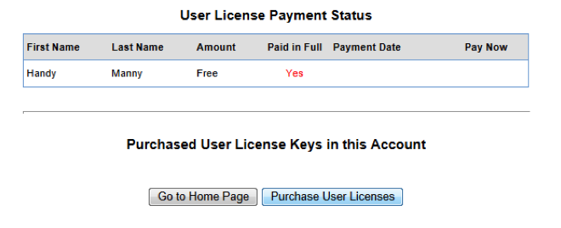
You are done when
“Paid in Full” will say “Yes”

Slide 15
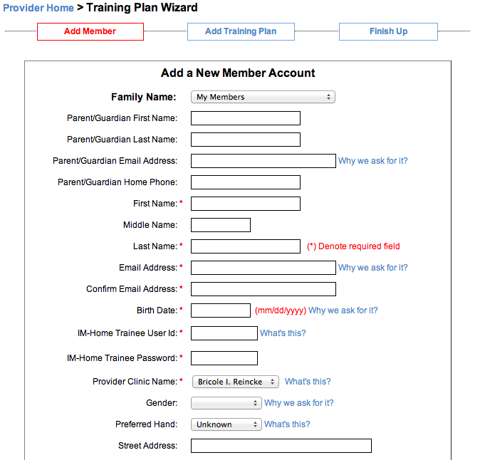
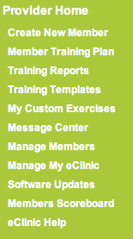
To get to the eClinic, visit www.imhome.org and click on the link at the top right hand corner
Set yourself up as a member

Slide 16
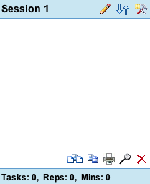
The eClinic Controls
The hammer & magic wand icon controls every task in a session.

Slide 17
The eClinic Controls
Arrows- Moves tasks up and down within a session

Slide 18
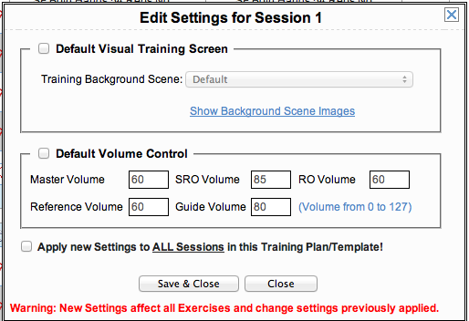
The eClinic Controls
Pencil- Edits volume and visual screen for session

Slide 19
The eClinic Controls
3 Papers- Inserts a blank session before or after a session

Slide 20
The eClinic Controls
2 papers- Copies a session to a new session

Slide 21
The eClinic Controls
Printer- Prints session

Slide 22
The eClinic Controls
Magnifying glass- Allows you to look at session details

Slide 23
The eClinic Controls
Red ‘X’- Deletes entire session

Slide 24
Lets focus on the Hammer & Magic Wand

Slide 25
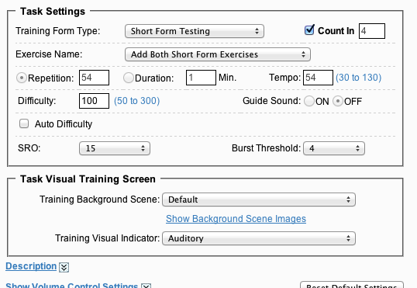
The eClinic Controls

Slide 26
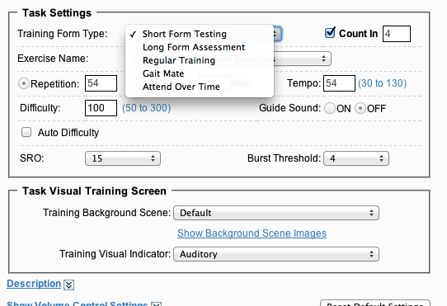
The eClinic Controls

Slide 27
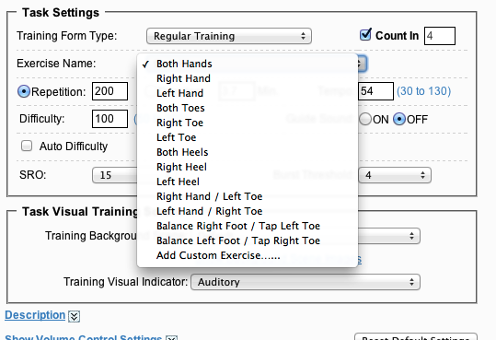
The eClinic Controls

Slide 28
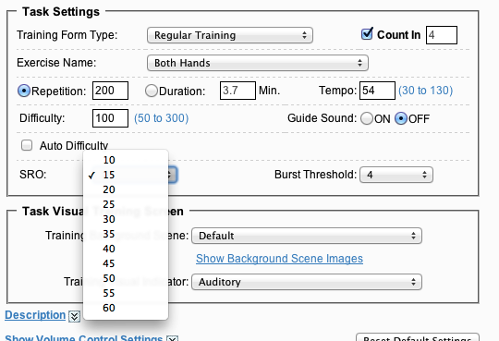
The eClinic Controls

Slide 29
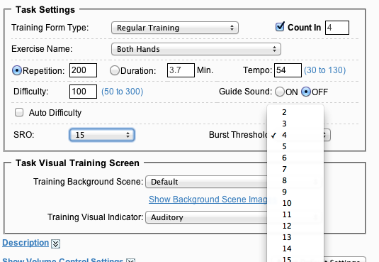
The eClinic Controls

Slide 30
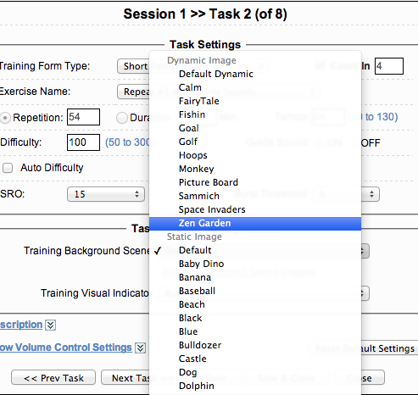
The eClinic Controls
IM-Home Universe has both static & dynamic graphics. Be sure to check out the games!

Slide 31
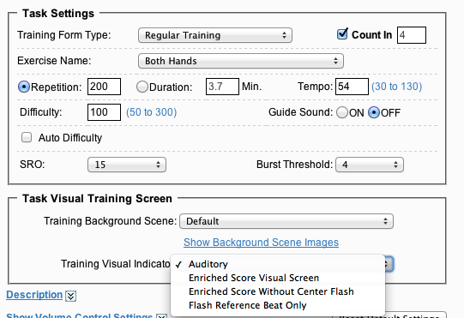
The eClinic Controls

Slide 32
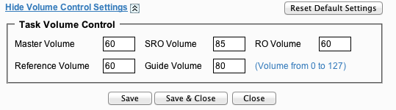
The eClinic Controls

Slide 33
Training Templates based on LFA Score
LFA Score | Template | Mode | # of sessions | Time/Session | Reps/Session | Type of Client | Dx
<100 ms | E, F | Visual to Auditory | 14 | 60 min | 1500-2800 | High Functioning | No Dx Possible ADHD Distractible
< 100 ms | A | Visual to Auditory | 30 | 30 min | 1300-2100 | High Functioning | No Dx Possible ADHD Distractible
100 – 200 ms | B | Visual to Auditory | 30 | 30 min | 1300-2100 | Medium Functioning | ADHD- light SPD- light
> 200 ms | C D | Auditory Visual | 48 | 30 min | 1300-2100 | Low Functioning | ADHD Asperger's Autism NVLD SPD Brain Injury Parkinson’s Stroke

Slide 34
Templates Based on Areas of Need
Focus Area(s) | Template | Mode | # of sessions | Time/Session | Reps/Session
Hands | G | Visual | 30 | 15 min | 800
Hands & Toes | H | Visual | 84 | 15 min | 800
Hands, Toes & Heels | I | Visual | 66 | 15 min | 800
Hands, Toes, Heels & Bilateral | J | Visual | 66 | 15 min | 800
Hands, Toes, Heels, Bilateral & Balance | K | Visual | 42 | 15 min | 800
Sustained Attention & Impulse Control | L | Visual | 90 | 15-30 min | 800-1600

Slide 35
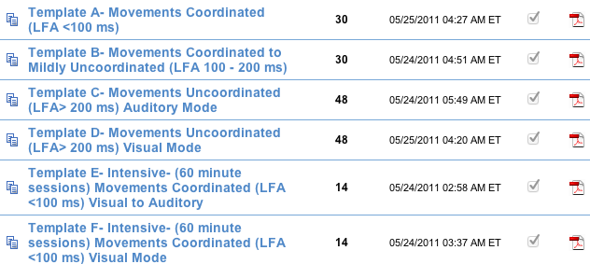
How the Templates look in the eClinic
Template Name
# of sessions
Click on Adobe PDF icon to see the entire template

Slide 36
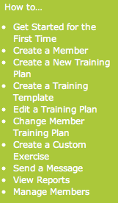

Need Help with the eClinic?
Watch tutorials online
  Located on right sidebar once you log into eClinic
Print out eClinic Training Manual

Slide 37
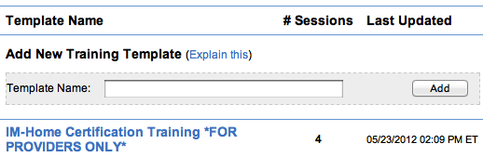
Homework
Play the role of client & provider
Log into the eClinic with your Provider UN & PW
  If you do not know it, email support@interactivemetronome.com
Set yourself up as a member
Pick IM-Home Certification Training Plan in the eClinic under Training Templates
Set- up demo equipment & authorize Free License
Complete first session

Slide 38
Homework
Play the role of client & provider
Log into eClinic as the provider
IMPORTANT- You need to take time in the eClinic to apply modifications to your demo training plan so you can conceptualize what your clients will experience.
Test the following functions:
  View reports
  Send a message
  Modify training plan- Change Visuals, Difficulty, Tempo, Add additional exercises to training plan, Apply a different template, Create your own training template, Create your own custom exercise
Complete session 2 training as a member and see the changes that you have made
Continue until all sessions are complete
Take Online Post-Test to receive link for course 2
Complete Course 2 to get the IM-Home Certified designation on the locator board

Slide 39

Questions
Clinical Support
clinicaled@interactivemetronome.com
Technical Support
support@interactivemetronome.com
Education Support
imcourses@interactivemetronome.com

