Slide 1
IM-Home Specialist Certification
Course 1 of 2
Presentation by: Sherrie Hardy
Hardy Brain Training • Camarillo, CA

Slide 2

Agenda
Ratings & Assessments
Your responsibilities as an IM-Home Specialist
How to choose a Template based on the LFA
Scheduling your clients IM-Home sessions
How to motivate your client remotely

Slide 3

Identifying Your Clients Goals
How does your client want their life to be like in the end?
Your role as a Provider is to help them create success
Notes:
Sherrie give client example

Slide 4
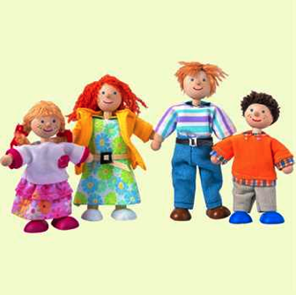
Rating Scale: Social/Emotional
Difficulty making eye contact
Difficulty with emotional control
Difficulty making/keeping friends
Lack of Self Confidence
Low Frustration Tolerance

Slide 5
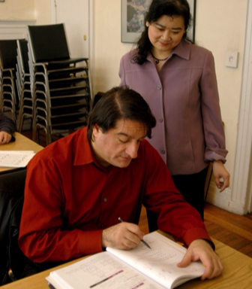
Rating Scale: Language
Difficulty with communication
Poor phonics
Poor initiation of reading/does not read to self or aloud
Poor spelling skills
Poor Reading Comprehension

Slide 6

Rating Scale: Physical/Motor
Has a “floppy” or “rigid” posture
Poor sense of Rhythm
Poor handwriting/fine motor skills
Poor Eating Habits
Poor Hand/Eye Coordination

Slide 7

Rating Scale: Sensory
Sensitive to sound - noises
Sensitive to touch – others touching self
Sensitive to particular foods
Sensitive to movement
Sensitive to visual input

Slide 8

Rating Scale: Attention/Organization
Poor task initiation
Poor sequencing when completing a task
Poor Auditory Attention
Poor Visual Attention
Poor overall organization, especially before and after school

Slide 9
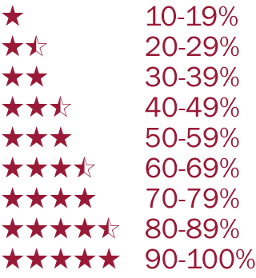
Pre, Mid & Post Ratings Scale Worksheet
Gauge where your clients are pre, mid and post IM training.

Slide 10

Medical History

Slide 11

Pediatric Assessments
Sensory Integration:
  The Sensory Profile
  DeGangi-Berk Test of Sensory Integration
  Sensory Integration & Praxis Test
Auditory Processing:
  Scan-C: Test for Auditory Processing Disorders in Children-Revised
Motor Skills:
  Movement Assessment Battery for Children (Movement ABC)
  Bruininks - Oseretsky Test of Motor Proficiency
  Beery Visual Motor Integration (VMI)
  Jebsen-Taylor Hand Function Test
  Minnesota Handwriting Assessment
  Test of Gross Motor Development

Slide 12
Pediatric Assessments
Articulation, Phonology, & Language:
  Clinical Evaluation of Language Fundamentals - 4th Edition
  Comprehensive Receptive & Expressive Vocabulary Test
  Expressive & Receptive One Word Picture Vocabulary Tests
  Gray Oral Reading Test
  Gray Silent Reading Test
  Illinois Test of Psycholinguistic Abilities
  Comprehensive Test of Phonological Processing
  Oral & Written Language Scales

Slide 13
Pediatric Assessments
Cognition
  Behavioral Assessment of the Dysexecutive Syndrome in Children
  Test of Everyday Attention for Children
  Children’s Category Test
  Intermediate Category Test
  Conners Continuous Performance Test II
  Delis-Kaplan Executive Functioning Scale
  Nepsy
  Rey Complex Figure Test
  Stroop Color & Word Test
  Symbol Digit Modalities Test
  Trail Making Test – Parts A & B
  Woodcock-Johnson Tests of Cognitive Ability

Slide 14
Pediatric Assessments
Developmental Assessment:
  Early Intervention Developmental Profile
  Developmental Programming for Young Children and Infants
  Peabody Developmental Motor Scales
  Test of Gross Motor Development
Functional Assessment:
  Adaptive Behavior Assessment System
  Miller Function & Participation Scales

Slide 15

Adolescent & Adult Assessments
Sensory Integration:
  Adolescent/Adult Sensory Profile
Auditory Processing:
  Scan-C: Test for Auditory Processing Disorders in Children-Revised
Motor Skills:
  Berg Balance Scale
  Dynamic Gait Index
  Jebsen-Taylor Hand Function Test
  Minnesota Manual Dexterity Test
  Purdue Peg Board

Slide 16
Adolescent & Adult Assessments
Articulation, Phonology, & Language:
  Boston Diagnostic Aphasia Exam – 3rd Edition
  Boston Naming Test
  Gray Oral Reading Test
  Gray Silent Reading Test
  Nelson-Denny Reading Test
  SCAN–A: A Test for Auditory Processing Disorders in Adolescents and Adults
  Booklet Category Test
  Comprehensive Receptive & Expressive Vocabulary Test
  Expressive & Receptive One Word Picture Vocabulary Tests
  Oral & Written Language Scales
  Peabody Picture Vocabulary Test
  Western Aphasia Battery
  Woodcock-Johnson Tests of Achievement
  Test of Language Competence

Slide 17
Adolescent & Adult Assessments
Cognition
  Test of Everyday Attention
  Rivermead Behavioral Memory Test
  Behavioral Assessment of the Dysexecutive Syndrome
  Wisconsin Card Sorting Test
  Woodcock-Johnson Tests of Cognitive Ability
  Controlled Oral Word Association Test (subtest of Multilingual Aphasia Exam)
  Cognitive Assessment of Minnesota
  Conners Continuous Performance Test II
  Contextual Memory Test
  Delis-Kaplan Executive Functioning Scale
  Intermediate Category Test
  Neurobehavioral Cognitive Status Examination
  Mesulam & Weintraub Cancellation Test
  Mini Mental State Examination
  Paced Auditory Serial Addition Test
  Rey Complex Figure Test
  Stroop Color & Word Test
  Symbol Digit Modalities Test
  Trail Making Test – Parts A & B

Slide 18
Adolescent & Adult Assessments
Activities of Daily Living:
  Kohlman Evaluation of Living Skills
Functional Assessment:
  Adaptive Behavior Assessment System
Want More Support with Ratings & Assessments?
When you are ready to grow your practice by 2 clients a month, we are piloting a new individualized coaching program and we would love you to join us.

Slide 19


Your responsibilities as an
IM-Home Provider
Set your member up in the eClinic
  just like you did with yourself on the demo unit
If user ordered online, you must “accept” him/her
Set-up the LFA for the client

Slide 20
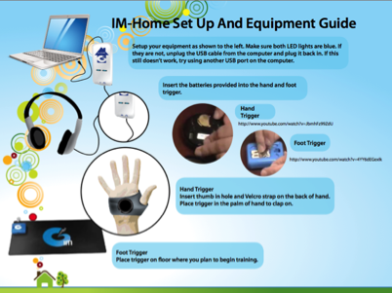
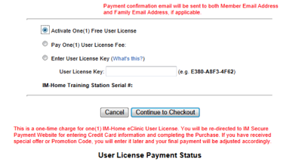
Your responsibilities as an
IM-Home Provider
Explain:
How to set-up the equipment
How to authorize a license

Slide 21
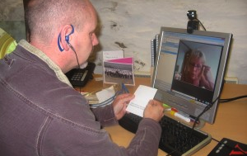
How to assess the LFA Virtually

Slide 22
Assign a Training Template based on the LFA
LFA Score | Template | Mode | # of sessions | Time/Session | Reps/Session | Type of Client | Dx
<100 ms | E, F | Visual to Auditory | 14 | 60 min | 1500-2800 | High Functioning | No Dx Possible ADHD Distractible
< 100 ms | A | Visual to Auditory | 30 | 30 min | 1300-2100 | High Functioning | No Dx Possible ADHD Distractible
100 – 200 ms | B | Visual to Auditory | 30 | 30 min | 1300-2100 | Medium Functioning | ADHD- light SPD- light
> 200 ms | C D | Auditory Visual | 48 | 30 min | 1300-2100 | Low Functioning | ADHD Asperger's Autism NVLD SPD Brain Injury Parkinson’s Stroke

Slide 23
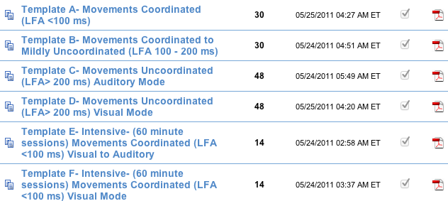
How the Templates look in the eClnic
Template Name # of sessions
Click on Adobe PDF icon to see the entire template

Slide 24

Need Help with the eClinic?
Watch tutorials online
Print out Training Manual

Slide 25
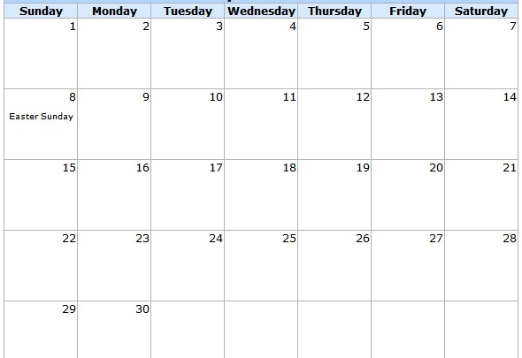
Lock down schedule with family

Slide 26

How to motivate your client in the home setting

Slide 27


Help parents motivate their child
Identify rewards for completing IM Sessions
  Less is more
    What is the smallest level of “buy-off”?
    Words of encouragement count
    Post best ms, # of burst or IAR somewhere he can see
  Never use food as a reward
  Point/token system towards a larger prize
  Treasure box
  Do a family weekly reward
  Sprinkle in surprises

Slide 28


Help Parents Stay Motivated
Give parents tools for helping their child master training
  Narrow down choices for child
Help parents recognize child’s progress
  Review training results
  Recognize independence
Illustrate to parents the benefit of using
IM equipment forever
  Before a big test
  Before a sporting event

Slide 29
Cooperation Chart

Slide 30

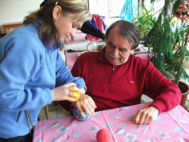
Keeping your adult clients on track
Be aware of each increment of progress & talk about it- they like to be recognized!
Coordinate with other therapy professionals about the “Big View” Goals

Slide 31
Ratings Journal

Slide 32
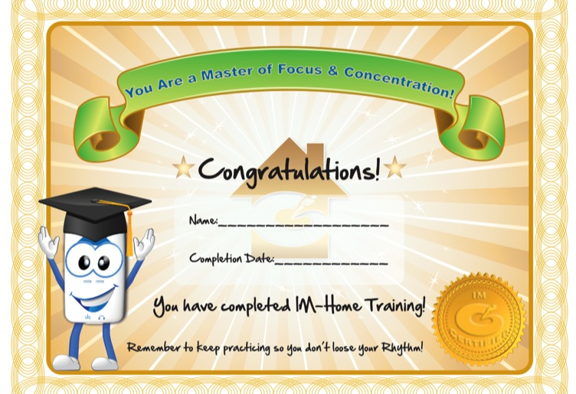
Certificate of IM-Home Completion

Slide 33
Case Examples

Slide 34
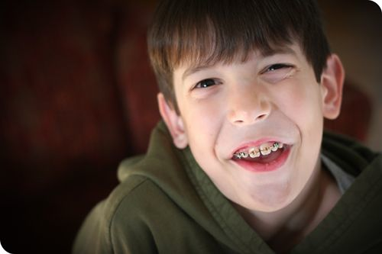
Phillip- 10 yrs
Autism Spectrum

Slide 35
Case Study Analysis- LFA
Phillip
Both hands – 263
Right hand – 226
Left hand – 249
Both toes – 327
Right toe – 312
Left toe – 385
Both heels – can’t move feet up and back
Right heel – 297
Left heel – 385
Right hand/Left toe – 356
Left hand/Right toe – 395
Balance Right /tap L – 376 – difficulty maintaining balance
Balance left /tap R– 391 – difficulty maintaining balance
Both hands/Guide sounds– 381
OBSERVATIONS: misses the beat, awkward movements, hand mitten itches, balance issues, guide sounds are difficult, hits are mostly early
CHOOSE TEMPLATE D OR C

Slide 36

Lesley- 13 yrs
Struggling in school (especially reading), attention problems, disorganized, difficulty completing school assignments

Slide 37
Case Study Analysis- LFA
Lesley
Both hands- 125
Right hand – 97
Left hand – 112
Both toes – 199
Right toe – 156
Left toe – 171
Both heels – 210
Right heel – 137
Left heel – 162
Right hand/Left toe – 205
Left hand/Right toe – 216
Balance Right /tap L – 125
Balance left /tap R– 136
Both hands/Guide sounds– 143
OBSERVATIONS: Complains about guide sounds in task 14, hits are early, difficulty coordinating both sides
CHOOSE TEMPLATE B

Slide 38
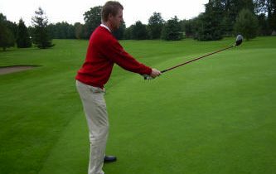
Cliff- 67 yrs plays golf, feels less organized, mental focus has declined, more difficulty completing tasks

Slide 39
Case Study Analysis- LFA
Cliff
Both hands- 76
Right hand – 84
Left hand – 91
Both toes – 85
Right toe – 74
Left toe – 79
Both heels – 97
Right heel – 68
Left heel – 78
Right hand/Left toe – 95
Left hand/Right toe – 105
Balance Right /tap L – 88 Balance left /tap R– 91
Both hands/Guide sounds– 94
OBSERVATIONS: Very motivated, concerned with guide sounds, smooth movements
CHOOSE TEMPLATE E or F

Slide 40

Materials you received today
Rating Scales
Sensitive Assessment Instruments List
Medical History
Training Templates
eClinic Training Guide
Scheduling Chart
Cooperation Chart
Ratings Journal
Certificate of Completion
Materials can be downloaded from:
http://imhome.org/index.php/home-specialist-coaching

Slide 41

Assign your client a LFA & a template based on score
Set a training schedule
Motivate the client and caregiver
Attend Course 2, to get IM-Home Specialist designation on locator board

Slide 42

Q&A Times
Want to ask specific questions about your IM-Home client with one of our experienced IM-Home Specialists?
Register online for select dates & times on the OnDemand Webinar Page, located on the Education page of the IM Website

Slide 43
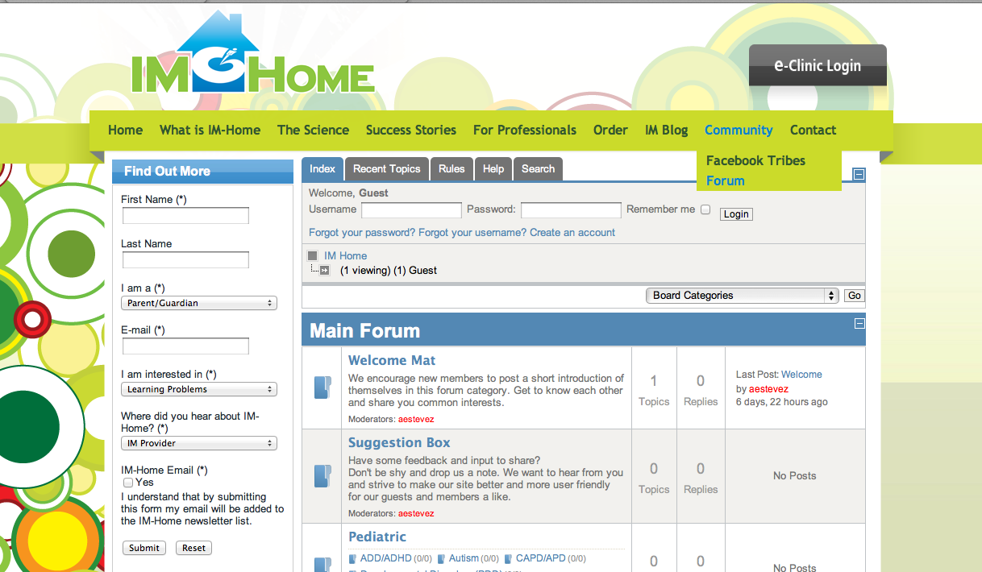
Connect after this course with the IM Forum
http://imhome.org/index.php/forum/index.html

Slide 44

Questions
Coaching Support
coaching@interactivemetronome.com
Clinical Support
avega@interactivemetronome.com
Technical Support
support@interactivemetronome.com

