Slide 1

IM Pro Clinical Certification Coaching
Course 2 of 2
Presented by:
April Christopherson, OTR

Slide 2
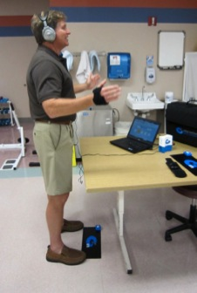
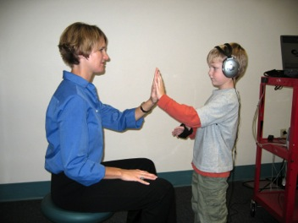
Agenda
Determining “Who” to treat
Learn when to modify the training
How to interpret reports
IM-Home review
HOMEWORK!
  Train your first client
  Register for IM-Home Certification
Notes:
5
How did he get there?.....

Slide 3


Review:
Who Is A Candidate for IM?
Standardized assessment
Functional assessment
You received a list of assessments on the Course Materials Page
Notes:
USE DISCIPLINE SPECIFIC TESTS TO EVALUATE CLIENTS FIRST!
Assess the following areas of performance (as appropriate):
Sensory, Motor, Cognitive, Language, Speech, Behavior, Academic, Community

Slide 4
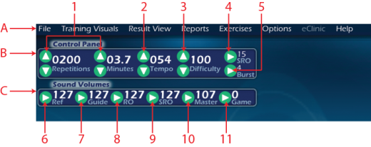
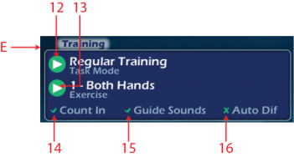
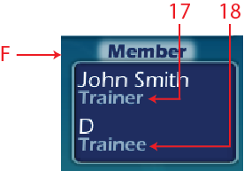


Software Features
*Go to Appendix Page A-2
Notes:
Follow an orderly pattern.
Advise that they will do several workshops today and will be competent with navigating through the IM by the end of the day. For now, just watch you point out the features and where things are located.
FILE - Review how to make new file and open existing file
FILE – Review how to SAVE AS
FILE – Review how to CLOSE a file
TRAINING VISUALS – Review the 4 types of Indicator Screens (you may need to demo them very briefly)
TRAINING VISUALS – Go over the options and demo a few backgrounds and games (child boy/girl, adult)
RESULT VIEW – Show the options and that this is where to switch which view you will see
REPORTS – Show them this is where reports are accessed and that they will be retrieving reports throughout the day to learn how to get to them and understand them
EXERCISES – Show them this and how to select which one to view and how to close out of this.
OPTIONS – Show them that this is where they will Authorize IM Hours (they can contact IM technical support for that when needed), and that this is where they can build an avatar for their client.
TRAINING PANEL – Mode, exercise, count in, guide sounds on/off, auto diff – change to Regular Training so you can show them how to adjust settings in Control Panel
PATIENT – Review information in this panel
CONTROL PANEL – Review features. Reps, minutes, tempo, difficulty, burst threshold, and SRO range (this is a new feature that allows you to expand/narrow the SRO range)
SOUND VOLUMES – Review volumes for all IM sounds and master volume, also review how to add background sound/music for the games (demo a game with background sound)
CURRENT SCORES – Review what is seen on this screen
IM INDICATOR – Review what is seen on this screen, MCU connection, hours remaining on MCU, etc

Slide 5
Settings and Definitions
REF: Reference Tone (Cowbell)
GUIDE: Buzzer sound when you’re way too early or way too late
RO: Rubber Band Twang that tells you is you’re within the set difficulty range of training
SRO: Reward tone that tells you if you are within the set SRO range.
Notes:
Review of software dashboard to training features

Slide 6
Settings and Definitions
IAR: How many SRO hits you get for task total
Burst: A setting to help motivate your clients to get SRO hits!
Difficulty: The setting that determines when your client hears the “Guide” sound
Tempo: How many beats per minute each task is (default is 54 bpm)
Notes:
Review of software dashboard to training features

Slide 7
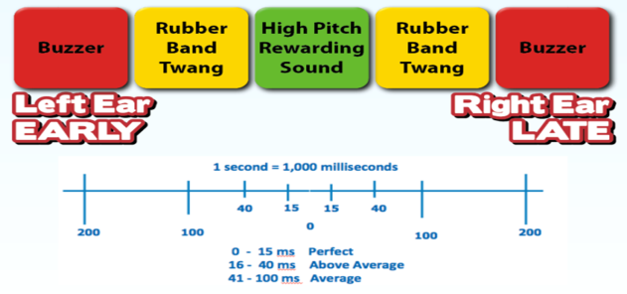
Starting Points
Introduce Guide Sounds slowly and with a clear order!
  Guide First (Buzzer)
  SRO Second (Reward Tone)
  RO Third (Rubber Band)
Notes:
Explain how to turn down volume on the dashboard to help client learn Guide Sounds

Slide 8

Training Keys
Use the information you got from the SFA and LFA to set up a training plan that follows the Phases of training. Everyone starts with learning the Reference Tone!
Notes:
Talk about using the SFA each session and using the LFA every 7-8 sessions to continually evaluate progress.

Slide 9

When to adjust the training
If your client didn’t do very well on the LFA but “soars” on first session, then move them ahead & CHALLENGE THEM

Slide 10
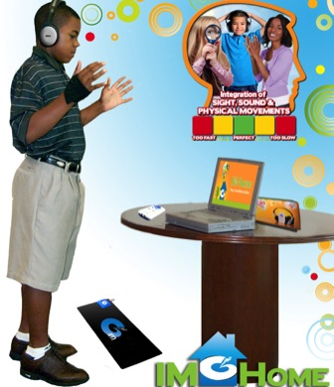
Moving Forward!
Gradually increase the reps as client is able to maintain scores consistently under 100 ms
As the scores drop lower add longer reps to EACH TASK
When able to do tasks with longer reps it’s a good idea to make sure clients can maintain their scores in the “average” range

Slide 11
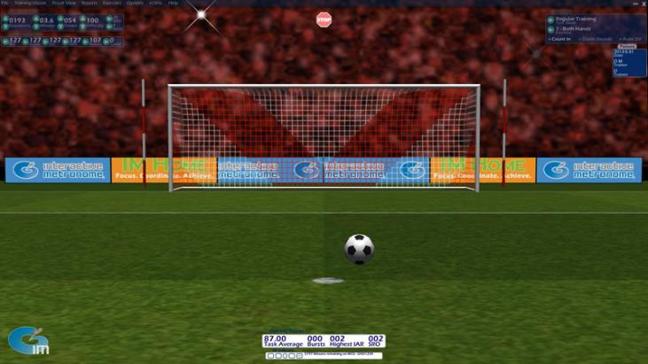
“Built In” Modifications
Notes:
Let’s talk about how the “games” screens from the 9.0 can enhance and motivate your clients! Discuss different screens and which ones might be useful for what – tracking (soccer, golf, BB, fishing); pure motivation to get greens (monkey, pictureboard, zen tree)

Slide 12
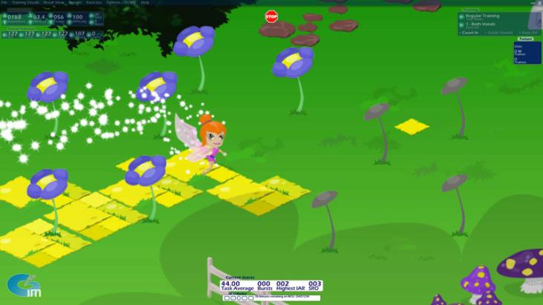
When?
Notes:
So…..the big question is, “When Do I Start to Use the Games?” See next slide

Slide 13
Gaming Guidelines
“When Do I Start to Use the Games?” Remember that each client is different and needs different training.
To help learn the guide sounds
To enhance training with visuals
To motivate
To improve overall scores and focus
To get the child to complete longer tasks
Notes:
So…..the big question is, “When Do I Start to Use the Games?” Remember that each child is different and needs different training. Also, remember that the games can be used for several different things:
To help learn the guide sounds
To enhance training with visuals
To motivate
To improve overall scores and focus (longer sessions)

Slide 14
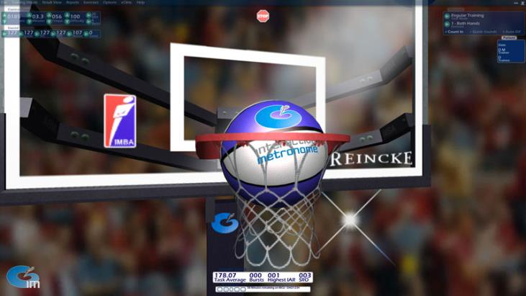
Visuals – Too Much?
Notes:
You can use the visuals to help with some tracking – HOWEVER – be aware that this is often TOO MUCH visual for a new learner, and unless the child is training in Phase 3-4 it might be overwhelming. Use your best judgment, which is often a “try and fail” method – Try it. If it succeeds, use it. If it fails, head back to simplicity! Remember that sometimes you won’t know if it’s too much right away. Sensory overload at times isn’t evident until the car ride home, or the next day. Remember to ask parents how the child did following big changes to training.

Slide 15
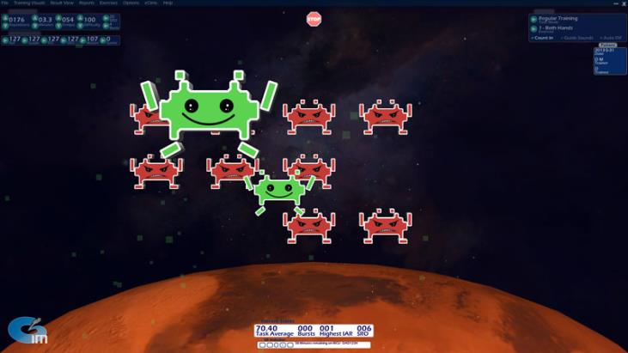
Motivate!
Notes:
You can use the games as a “reward” session between work sessions or as a motivation – “Johnny, if you get a score below 65 ms on this two minute task, I will let you choose a game to play for your next 2 minute task!”

Slide 16
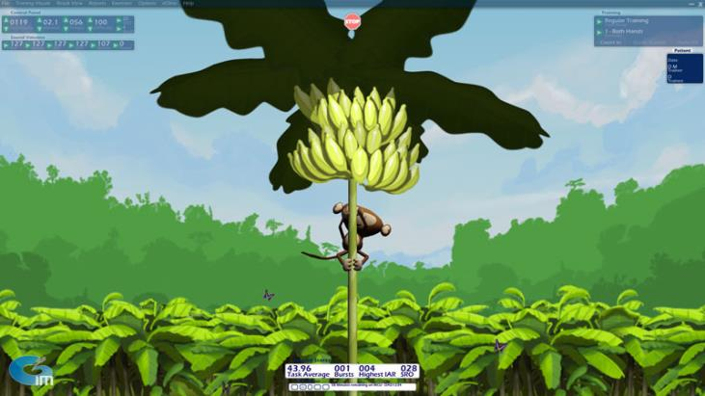
Rewards!
Notes:
Remember that to motivate the kids to get “greens” we can now adjust the level of SRO from 10 to 60 ms. When you increase the SRO levels, you increase the possibility that the child will succeed at getting greens more, which gives two rewards – the screen reward (visual) and the SRO bell reward (auditory)

Slide 17
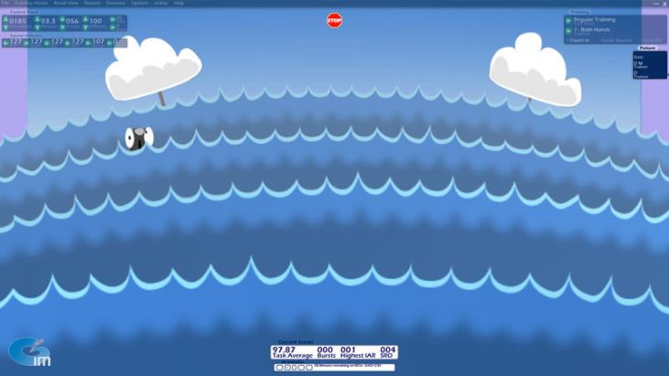
Train Longer, Focus Better
Notes:
Once a child is training in phases 3-4, you can use the games to help with longer tasks – Remember to watch your settings! The child still needs to work at this, so the settings continually need to be changing to accommodate their level of skill.

Slide 18
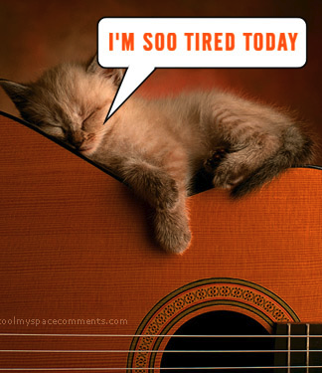
Training Glitches
An “off” session or two can be expected at some point in the training
  Don’t change plan just yet
  Some clients have a few poor scores right before they make a big gain in their timing
  If lack of progress persists, it is time to reassess

Slide 19
IM Training
Frequency, Intensity & Duration
Repetition is critical.
  Repetition is required in order to make lasting, functional changes in the brain.
  Performing a little IM here and there or for a short period of time will not lead to functional neurological change.
Aim for 3x/week with minimum of 30 minutes of training per session.
Duration varies depending upon baseline timing skills & other factors
IM Home training may be beneficial to meet the minimum recommended frequency & when longer term training is warranted

Slide 20
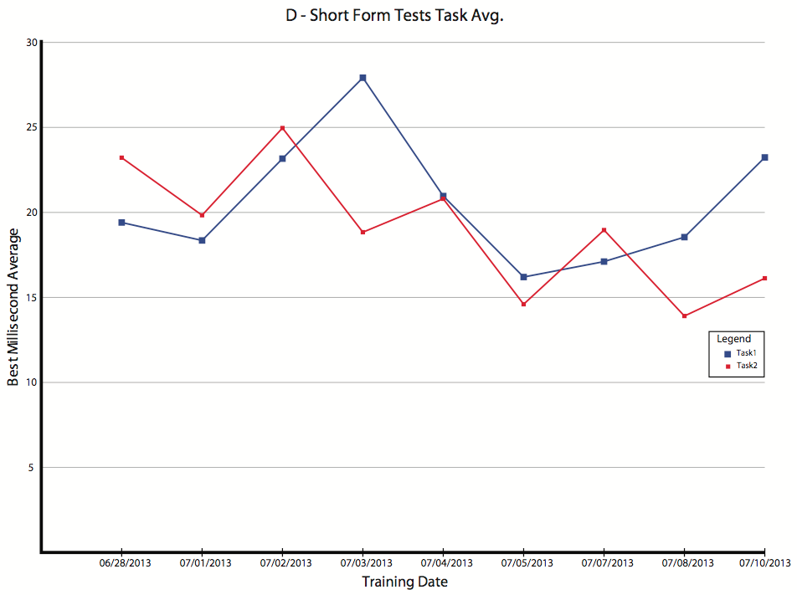
Interpreting Results
Strategies to customize your approach with the pacing of IM activities include:
  Adjusting the tempo
  Adjusting the duration of IM tasks
  Adjusting the frequency of IM tasks
  Supplementing IM tasks with age-appropriate incentives
  Monitoring IM participant for signs of distress or fatigue
Notes:
- The first thing to look for is the difference between task 1 and task 14. For most people, task 14 will be a higher score because of the extra distraction of the guide sounds. This will give you an idea as to where to start their difficulty level for their training. When you see higher scores, begin with fewer reps.

Slide 21
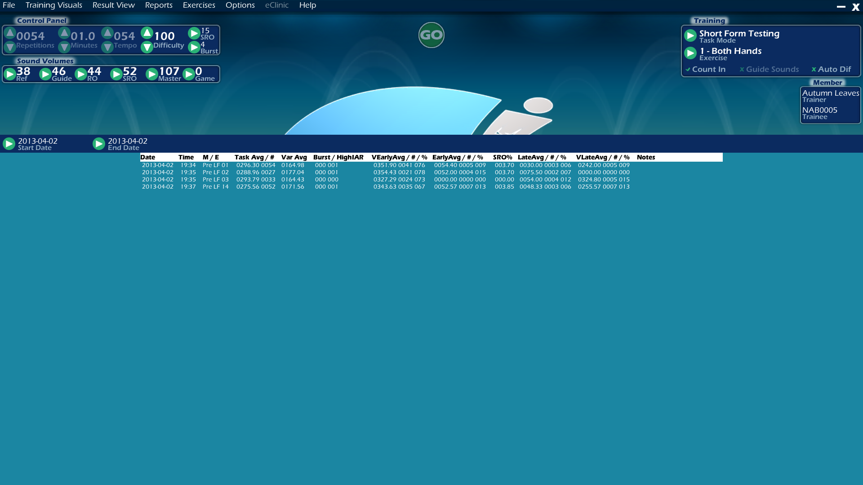

Interpreting Results
“Data List” View
Notes:
- The first thing to look for is the difference between task 1 and task 14. For most people, task 14 will be a higher score because of the extra distraction of the guide sounds. This will give you an idea as to where to start their difficulty level for their training. When you see higher scores, begin with fewer reps.

Slide 22
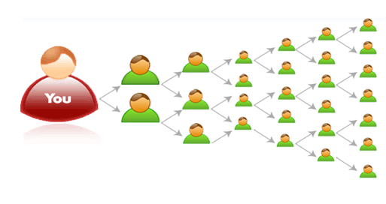
Expand you services with
IM-Home
Extends Reach
Builds Volume
Efficient Therapy Management Tool
Sets-Up Patients for better overall outcomes

Slide 23

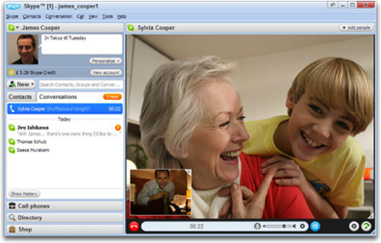
Models of Use
Hybrid
  Mix of In-Clinic & Home allows patient to bill insurance part of the time
Virtual
  Great for those with travel issues or a discharge program
Notes:
Let’s face it. IM was meant to be offered for home use. It’s not a realistic expectation for a family to come to the clinic as much as IM needs to be done.

Slide 24
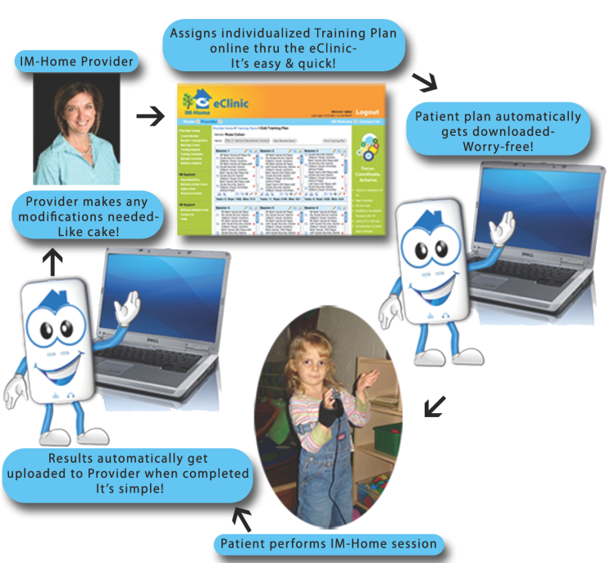
IM-Home eClinic
PREVIEW

Slide 25

Get IM-Home Certified
Sign up to attend the next step in your training!
IM-Home Certification and Coaching Program
0.3 AOTA & ASHA CEUs
FREE DEMO UNITS included with all
IM Pro Universe Purchases!

Slide 26

Start training your first client!
  If you’re not comfortable to start training your first client, complete a 12-day training on yourself .
Don’t forget to register for the
IM-Home Certification Program
Take online post test
Upon completion you will receive
0.4 AOTA & ASHA CEUs

Slide 27
QUESTIONS? NEED MORE HELP?
RESEARCH! Use the “Self Study” manual to find references and definitions
PLAY! Use this yourself over the course of several days or weeks
TEST! Find a client to practice on – a friend, neighbor, or family member
WATCH! Go online and watch videos
LEARN! Sign up for webinars

Slide 28


Contact Information
Interactive Metronome, Inc
Toll free: 877-994-6776
Education Support
imcourses@interactivemetronome.com
Technical Support
support@interactivemetronome.com
Clinical Support
clinicaled@interactivemetronome.com
  Like us on Facebook!
  Follow us on Twitter!
  @imetronome
Notes:
The F and the T are links to the appropriate pages!

