Slide 1
Marketing 101
Holding an Open House
  Presented by: Sherrie Hardy
  Hardy Brain Training

Slide 2

4 Crucial Sequential
Steps to Success
Get them in the door
See if you can help them
Help them realize you can help
Then treat

Slide 3
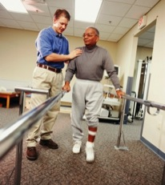

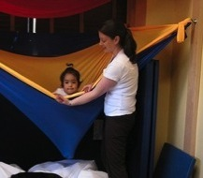
Grow your practice with 2 types of open houses
Local Professionals
  Expanding your reach
Local Patients
  Who do you want to attract?

Slide 4
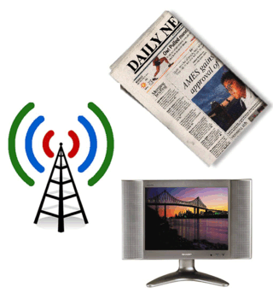
Publicizing your event

Slide 5
Create Materials
IM has materials already made for you
  Provider Login under Marketing & PR
    PowerPoint(Ped & Adult)
    Tri-fold brochures
    Formatted Case Studies by Dx
    Video Clips by Dx
    Free Screening Form
    & many more Flyers!

Slide 6
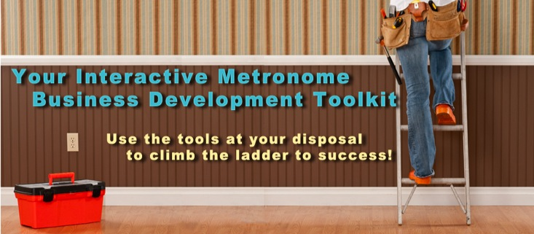
Provider Login Marketing Resources
To Login visit www.interactivemetronome.com
Click Provider Login in the top right corner
Enter username and password, e-mail support@interactivemetronome.com if you do not know your password
Click on Marketing & PR to access the Business Development Toolkit

Slide 7

Marketing 101 Videos
Advertising Support
Public Relations Tips and Templates

Slide 8

Case Studies
Brochures
Post Cards
Flyers
Posters
Tradeshow Banners
Stock Images
Logos
Appointment Cards
Business Cards
Facebook Cards

Slide 9

Web Banner
E-mail Marketing Templates
Desktop Wallpaper

Slide 10

Just copy the code provided and embed these videos into your website
Promotional Videos by Dx
Testimonial Videos
News Clips
YouTube

Slide 11

Learn how to create your Facebook Business page
Use our Blogs as a resource for content
Use our stock photos on your page to dress it up

Slide 12
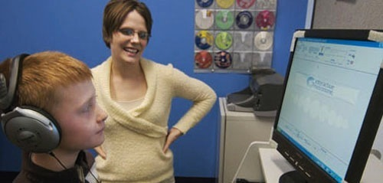
Set-up your space

Slide 13

Follow-up
Personalized E-mail
  Look into auto respond
Phone
Text

Slide 14

Ongoing events that create buzz

Slide 15

Ultimate Goal
Create your personal brand for word of mouth referrals

Slide 16

Questions
IM System Coaching Program Features:
Clinical Certification
IM-Home Certification
IM-Home Specialist Certification
Go to the Education Page & Click on the Coaching button to Register

