Slide 1
Marketing 101
Flyers, Brochures, Press Releases & Face-to-Face Selling
  Presented by: Sherrie Hardy
  Hardy Brain Training

Slide 2

Agenda
Flyers
Brochures
Press Releases
Face-to-Face Selling

Slide 3
Flyers
Cost of a Changed Life
Developmental Milestones
Secret Ingredient of IM
How the IM System Works
IM-Home Equipment
Dx Specific Case Studies

Slide 4

Your Clinic Name
Your Name
Your Phone #
Your E-mail
Notes:
How to charge

Slide 5


Slide 6
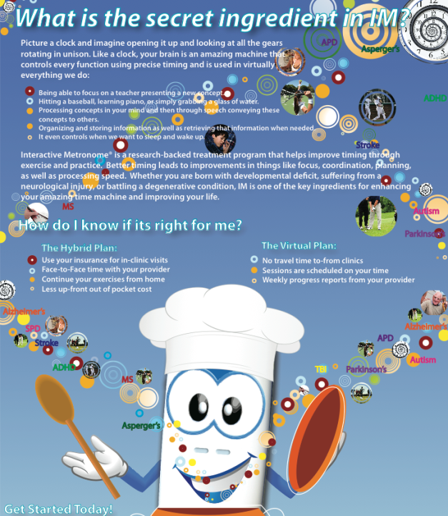

Slide 7
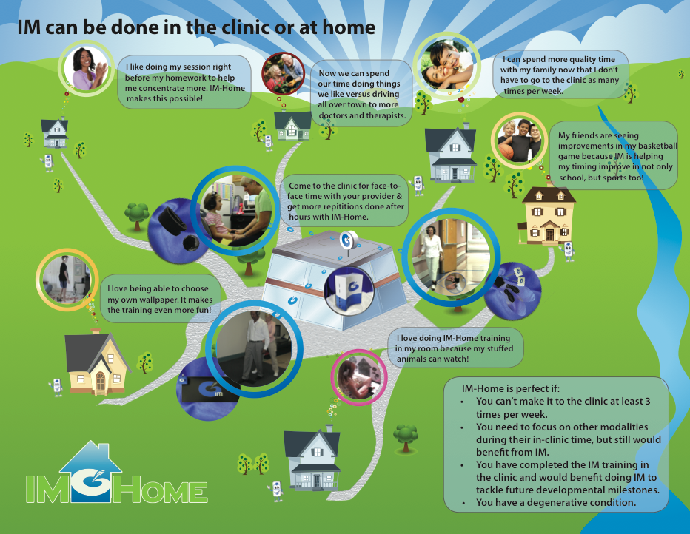

Slide 8
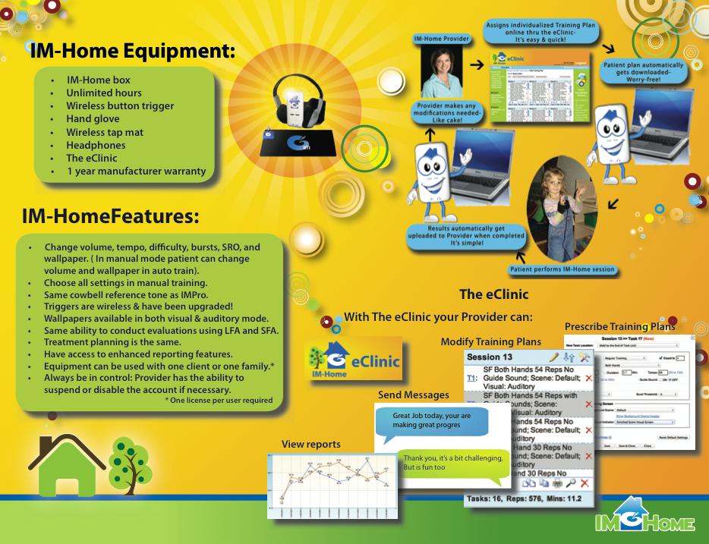
Notes:
What is IM-Home?

Slide 9

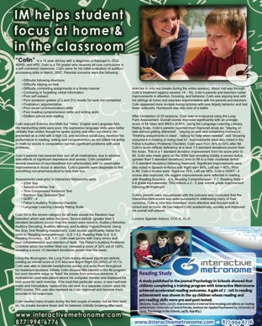


Case Studies
http://imhome.org/index.php/success-stories.html

Slide 10
Brochures
Ped Brochure
Adult Brochure
Is IM-Home Right for me?

Slide 11


Pediatric Brochure

Slide 12
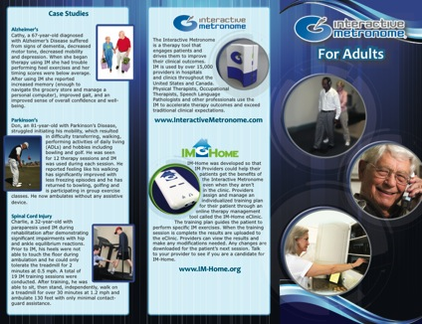
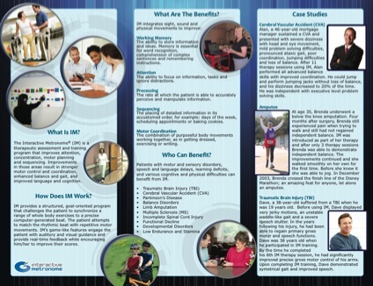
Adult Brochure

Slide 13


IM-Home Brochure

Slide 14

Provider Login Marketing Resources
To Login visit www.interactivemetronome.com
Click Provider Login in the top right corner
Enter username and password, e-mail support@interactivemetronome.com if you do not know your password

Slide 15

Marketing 101 Videos
Advertising Support
Public Relations Tips and Templates

Slide 16

Case Studies
Brochures
Post Cards
Flyers
Posters
Tradeshow Banners
Stock Images
Logos
Appointment Cards
Business Cards
Facebook Cards

Slide 17

Web Banner
E-mail Marketing Templates
Desktop Wallpaper
News Clips
YouTube

Slide 18

Just copy the code provided and embed these videos into your website
Promotional Videos by Dx
Testimonial Videos
News Clips
YouTube

Slide 19

Learn how to create your Facebook Business page
Use our Blogs as

Slide 20
Creating Customized Materials
Where to get printed
  Vista Print
  Local Printer
Wording
  Highlight Features & Benefit
Photos
  Take patient photos, get releases
  IM stock photos

Slide 21

Press Release
Research It
Format It
Have some News
  Open House, Feature Client Progress
Templates available on IM Provider Website

Slide 22

Face-to-Face Selling

Slide 23

Questions
IM System Coaching Program Features:
Clinical Certification
IM-Home Certification
IM-Home Specialist Certification
Go to the Education Page & Click on the Coaching button to Register

