Slide 1
CERTIFICATION AND COACHING:
IM PEDIATRIC BEST PRACTICES
MODULE 2: MODIFYING IM TO PEDIATRIC POPULATIONS
By Mary Jones, OTR/L, DipCOT,
Sensational Kids, LLC
Brain Focus International, Inc.

Slide 2

Outcome Goals for Module 2
Homework assignment review and post-test from previous module.
Modification tools for setting up physical environments and sensory environments
Examples of sensory modifications
Examples of setting up physical
environment
Review of module 2
Preparation for module 2 homework

Slide 3
Review of Post-Test from Module 1
Which list is accurate in describing the four steps that are essential for incorporating IM into pediatric practice?
    Creativity; flexibility; embracing the principles of the IM systems; using a specific protocol for each diagnosis
    Using age-specific templates for IM training; flexibility; using a specific protocol for each diagnosis; thinking ‘outside the box’
    Flexibility; Creativity; embracing the principles of the IM systems; being comfortable thinking ‘outside the box’
    Creativity; flexibility; exclusively using the Regular training exercises 1-13; making sure each client completes all assignments within each session.
Answer: C

Slide 4
Review of Post-Test Module 1
2. True or False: Modifying your approaches to the Interactive Metronome® systems are key to success with pediatrics.
Answer: True

Slide 5
Review of Post-Test Module 1
3. Interactive Metronome® training can help in the following areas:
  Educational
  Therapeutic
  Lifestyle
  All of the Above
Answer: D

Slide 6
Review of Post-Test Module 1
4. True or False: An office setting is necessary to complete IM training.
Answer: False

Slide 7
Review of Post-Test Module 1
5. True or False: Allowing variances in positioning is a key tool to success in Interactive Metronome® training.
Answer: True

Slide 8
The Key to IM Success:
Modify for Engagement!
Be Spontaneous for Novelty!
Increase Repetition for
Synaptic Growth!

Slide 9

Techniques for Success
Positioning alternatives
Physical Environment
Sensory Environment
Motivation Strategies
Tempo/Timing variance
Feedback Strategies
Interpreting Data
Pacing of activities and themes
Duration of tasks and sessions
Building Relationships – allowing control
Switch choices and Access

Slide 10
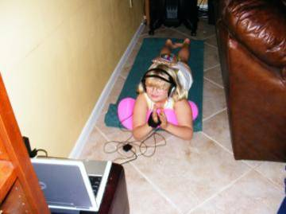
Modifying IM activities...
Physical environments
Size of room/space
Seating options
Lighting options
Available wall space
Available floor space
Storage for small/large items

Slide 11
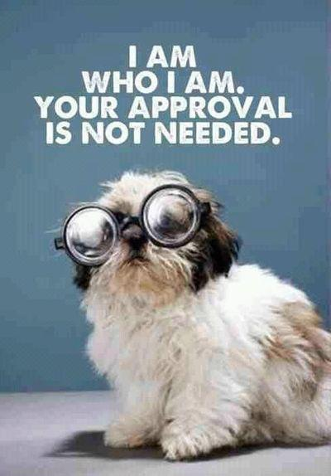
Critical Thinking:
Preferences of the child
Interests of the child
Sensory parameters
Physical abilities
Emotional tolerance
Engagement

Slide 12


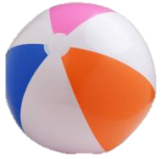
Useful Items for Modification Kit
Colored tape
Self-adhesive Velcro strips
Non-slip matting
Various textured/sized balls
Visual timer
Balloons
Bubbles
Stickers
Chewables
Suckables

Slide 13
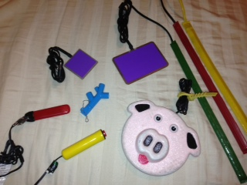
Compatibility Switch Choices

Slide 14
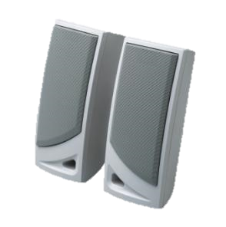
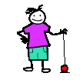

Variety of switches/triggers
Cable splitters
Portable speakers
Variety of headphones
Soft squishy bug toys
Selection of small kids toys
Silk scarves
Ball on a string
Flashlights
Word/Letter/Picture flash cards
Soft knit gloves
Sanitizing hand wipes

Slide 15
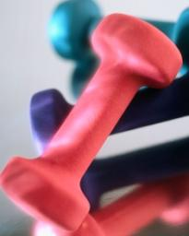
Larger items to consider:
Hopper or rebounder trampoline
Bosu
Balance disc
Therapy ball
Aeromat or large foam cushions
Weighted balls (3-5#)
Mop handles/trekking poles
Weighted items (i.e., vest, blanket, bean bags)
Portable sports equipment (i.e., baseball bat, hockey stick, etc.)
Portable floor mat

Slide 16
Sensory Modulation Considerations
Sensory modulators are mechanisms that help to define and control a child's sensory environment to facilitate attention/learning. These can be either child-led or facilitated through the provider. (i.e., calming measures such as decreased stimulation in the environment, increased pressure through use of weighted vest, positioning, activity structure, etc.)
Sensory modulation - observe for a child's ability to take in and balance out their sensory worlds
Behavioral regulation - observe for a child's ability to apply sensory modulation skills to age appropriate behaviors
Achieving a “ready alert state” - observe for a child's optimum state of organization and readiness to adapt to new challenges

Slide 17
Sensory Modifiers
Lighting – too bright, too dim, reflective glare from flooring or mirrors, flickering from fluorescents, shadows, glare from the sun
Space – too large, too confining, too cluttered, too much visual information, too noisy, too busy
Sounds – too loud, too quiet, a clock ticking, a tap dripping, a fridge buzzing, background noises, high traffic area (people and vehicles), overhead paging systems
Surfaces – too soft, too hard, too rough, too smooth, too slippery, too cluttered
Scents – noxious smells, musty smells, perfumes, non-preferred food smells

Slide 18
Signs of Distress/Fatigue/Overload
Oral motor overflow Sweating Changes in skin color Marked increases/decreases in postural control Aversion to sensory input Increases in motor output Changes in respiratory rates Increased fidgeting behaviors Increased vocal distress Increased verbal distress Decreased attention/engagement
Notes:
Oral motor overflow (tongue protrusion/jaw clenching/lip
chewing)
Sweating
Changes in skin color (increase skin coloration to the neck and
face areas/increase pallor)
Marked increases/decreases in postural control (head and neck
tightness or slumped/stacked postural patterns-sitting or lying
down on the floor, decreased participation)
Aversion to sensory input (inability to tolerate wearing
headphones/inability to tolerate volume settings/inability to
attend to visual input)
Increases in motoric output (pacing/fidgeting)
Changes in respiratory rates (breath holding/increased
breathing patterns)
Increased fidgeting behaviors (rubbing face/nose/eyes/body
parts)
Increased vocal distress (grunting/sighing)
Increased verbal distress (requests for help, to cease activity)
Decreased attention/engagement

Slide 19
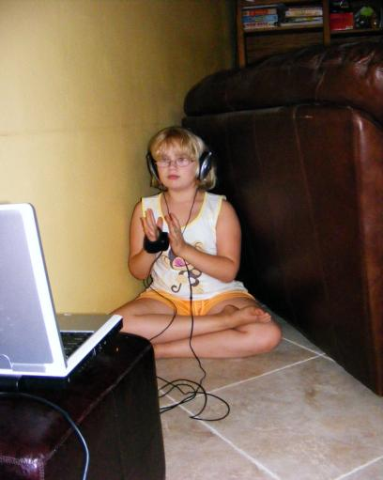
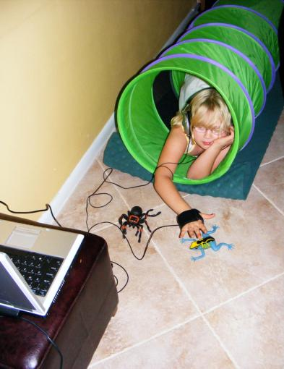
Modification Examples:
Setting up Physical Environment
Creating a small space
Customizing a fun space to a child’s sensory needs

Slide 20
Modifying Physical Tasks
Upper Body IM Task +
Lower Body IM Task +
Stabilize posture in bean bag
Promote lower body balance tasks
Add dynamic lower body tasks
Upper body sequencing task
Ball on a string tasks
Throw/catch ball sequence
Combine with Wii Sports (i.e. basketball)

Slide 21
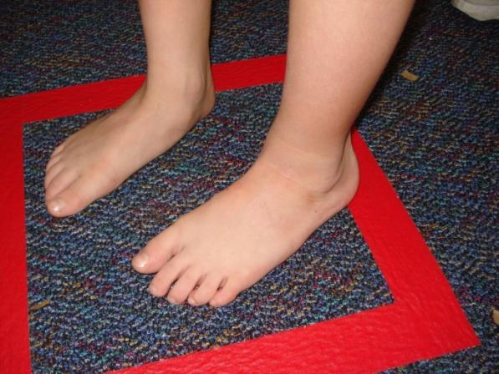
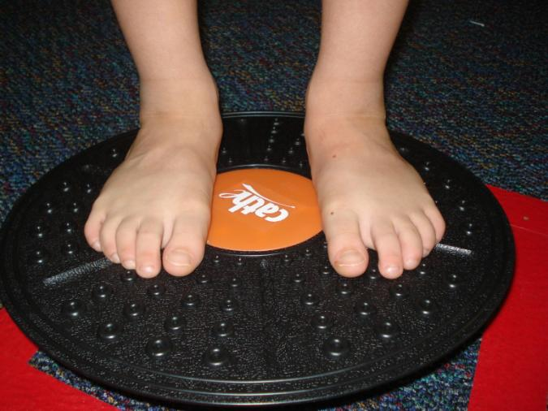
Defining personal space
(also useful are traditional carpet squares; colored spots; totes; tubs and boxes)
Increasing balance challenge within defined space.

Slide 22
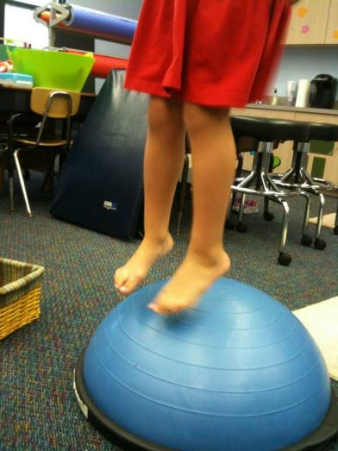
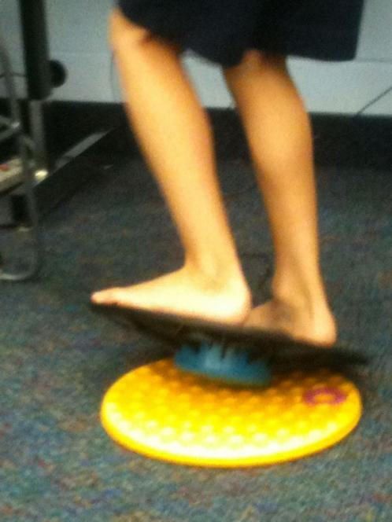
Stabilizing balance disc for modified IM challenge
Dynamic balance activities with Bosu (half ball on a platform)

Slide 23
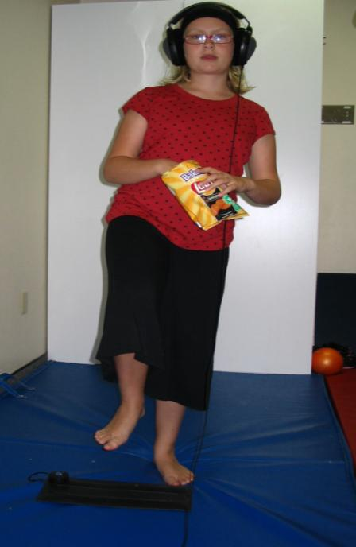
Multi-tasking during IM – snack time or lunchtime during tap mat activities. When adding challenge, keep a close eye on: duration; tempo; volume settings and signs of a child’s fatigue.

Slide 24
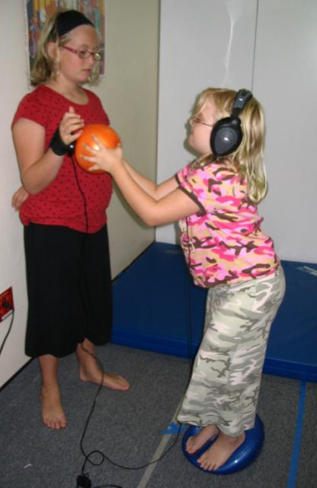
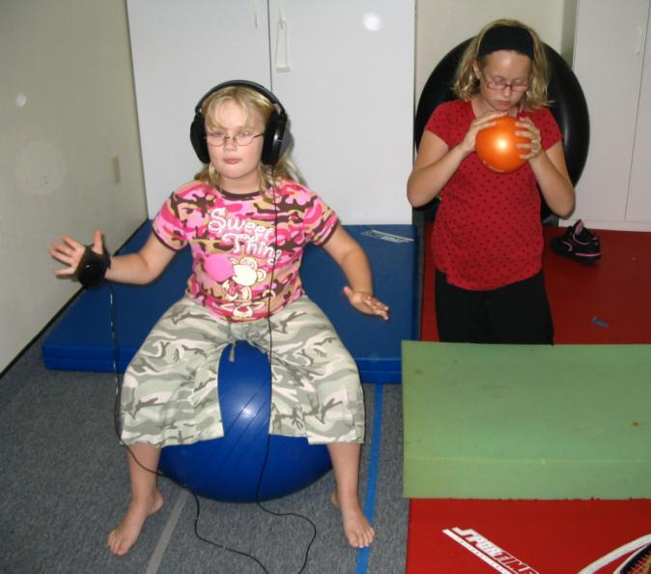
Concurrent IM task with rhythm activity – use speakers at the same time as headphones and involve non-IM students in rhythm activities on the same beat.
IM challenge with peer – one to work; one to support and then switch!

Slide 25
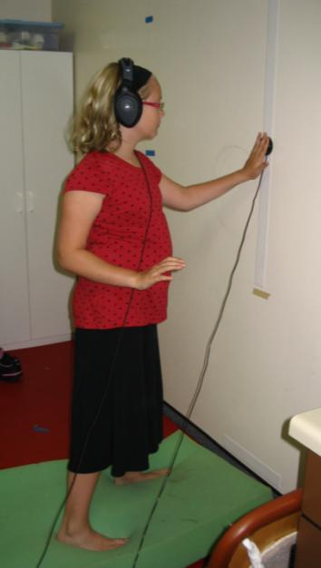
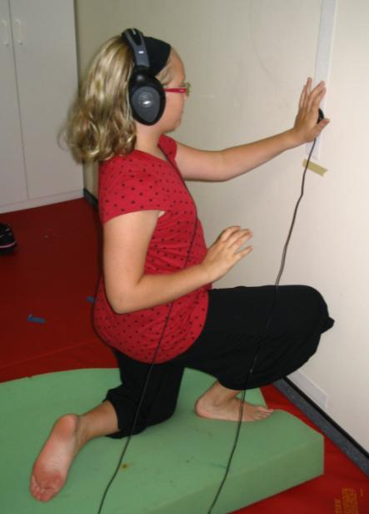
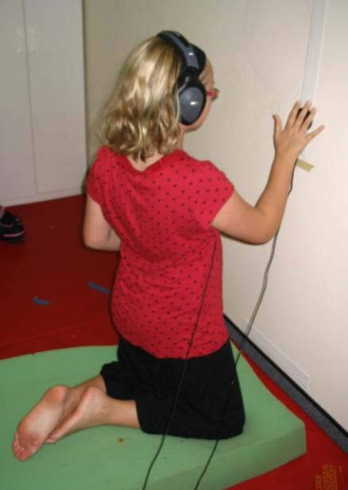
Postural Stability Activities
Rotation through shoulder and pelvic girdles.
Segmentation through upper body/lower body.
Anterior pelvic tilt with
upright stability

Slide 26
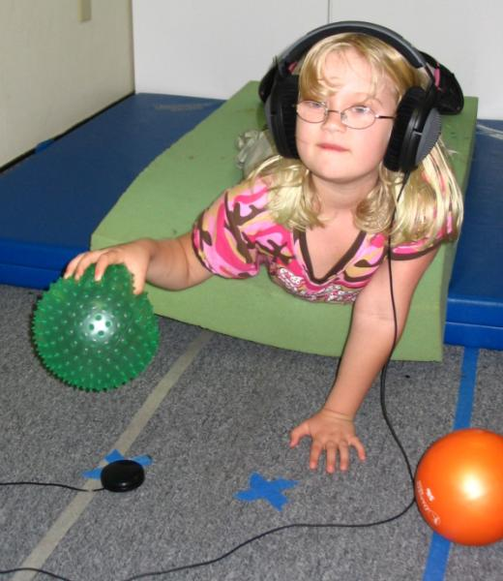
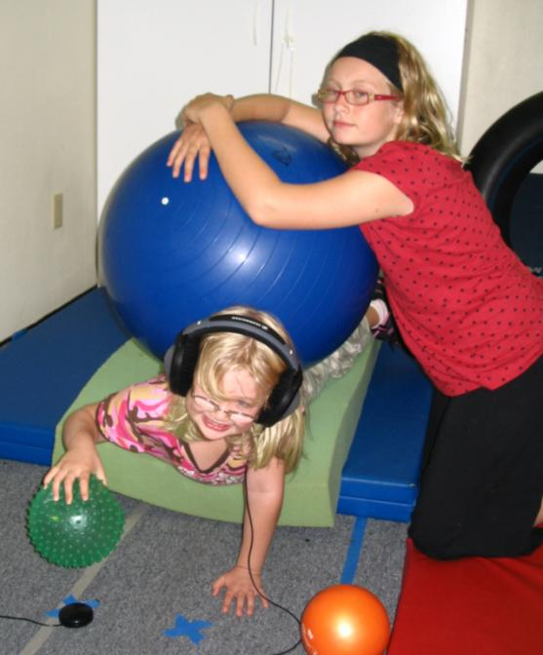
Resistance tummy time with ball challenge!
Prone with upper extremity weight-bearing; ball tap onto button switch.

Slide 27
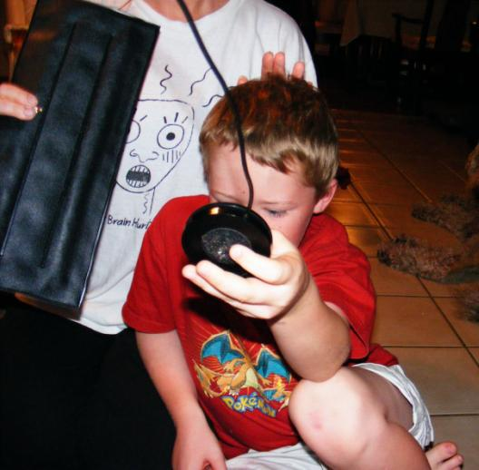
Triggers in motion – dangle or hang wireless switches or place wired switches on a moving target.

Slide 28
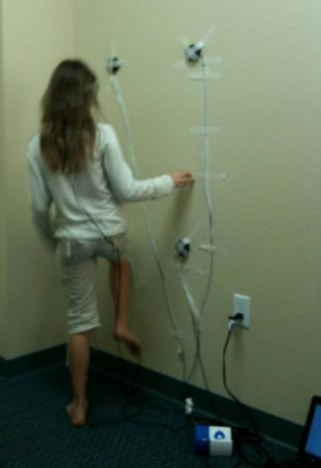
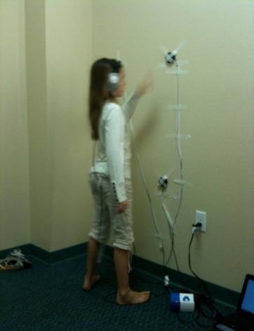
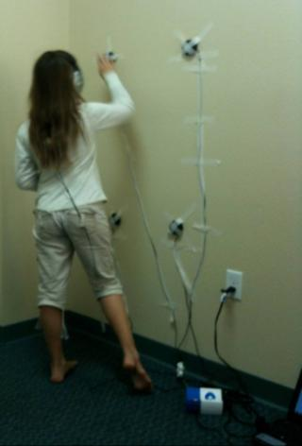
Use of wall space to create a vertical cross-hemispheric sequence
(wired or wireless switches may be taped gently to a wall or door surface)

Slide 29
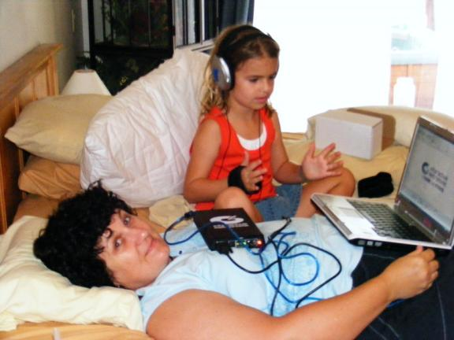
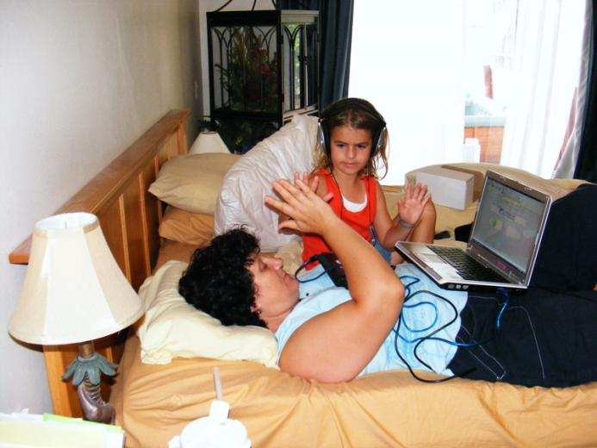
Modified Expectations
(home based)
Can I still do my IM
while you are resting?!

Slide 30
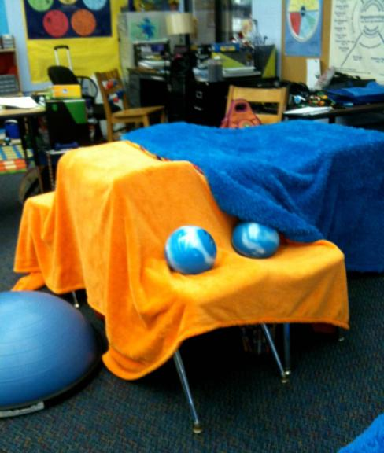
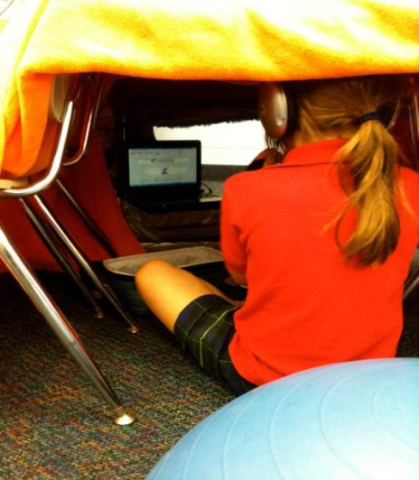
Creating Playful Environments with IM (below one classroom cave with 4 chairs; 1 desk; two blankets and 4 weights)

Slide 31
Turn Taking – impacts both physical and sensory set up
Movie: Slide 31 – Turn-taking…
Notes:
Slide 30 – Turn-taking during IM training.mp4

Slide 32
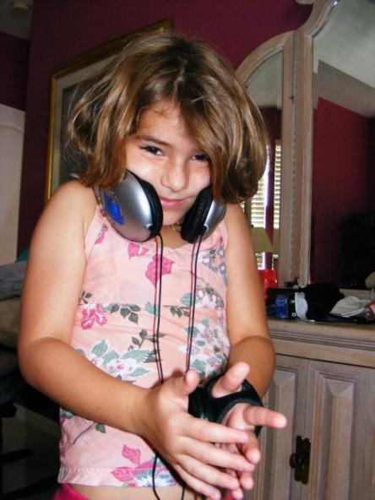
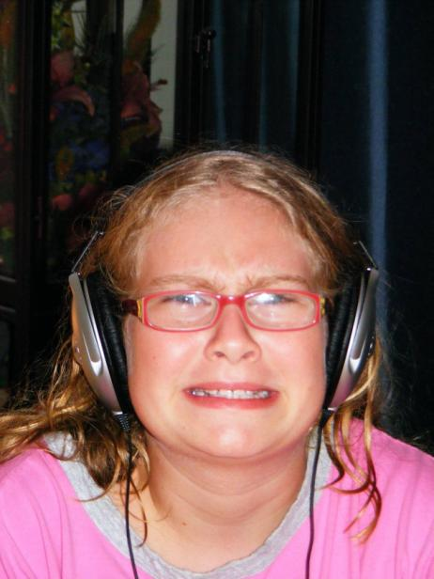
Sensory Environment

Slide 33
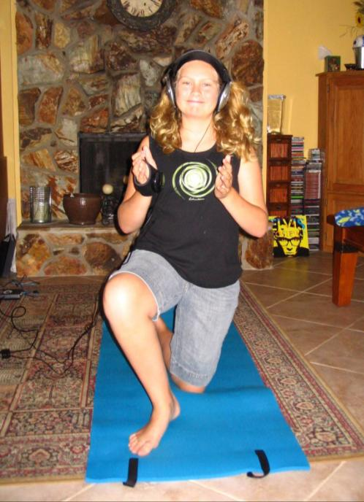
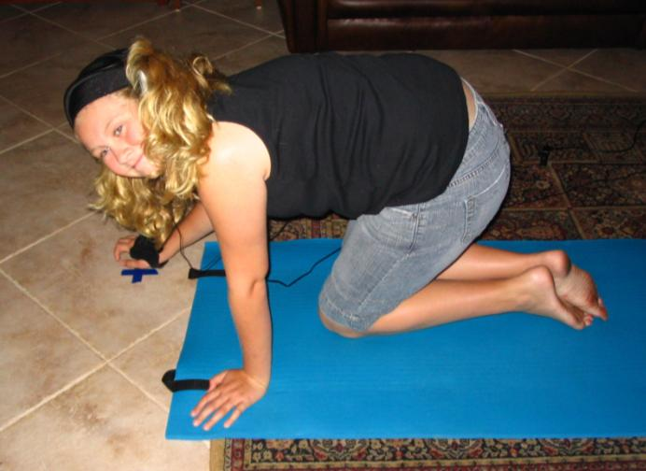
Postural comfort measures – Soft mat for knees

Slide 34
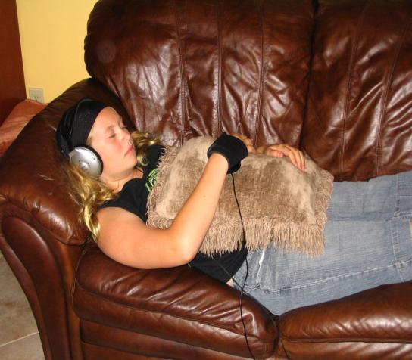
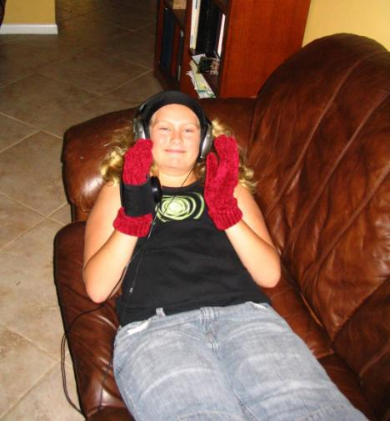
Extreme Comfort Measures – soft cushions and soft gloves
(after school wind down with IM)

Slide 35
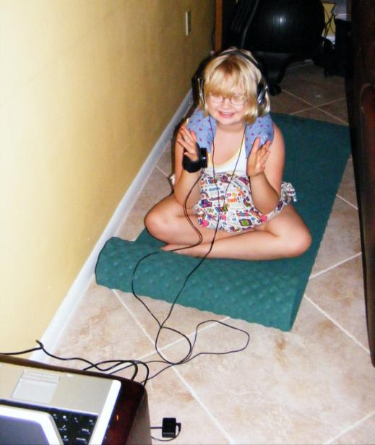
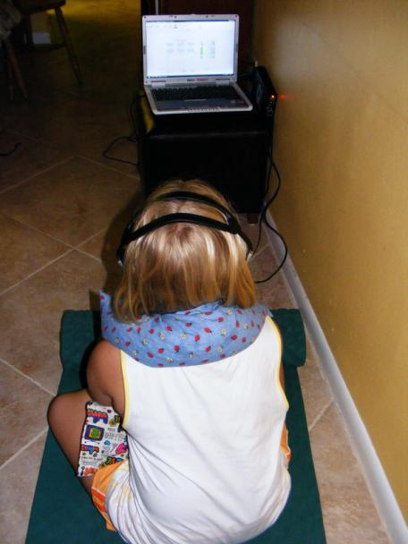
Postural Calming – smaller play space and weight through vertical core.

Slide 36
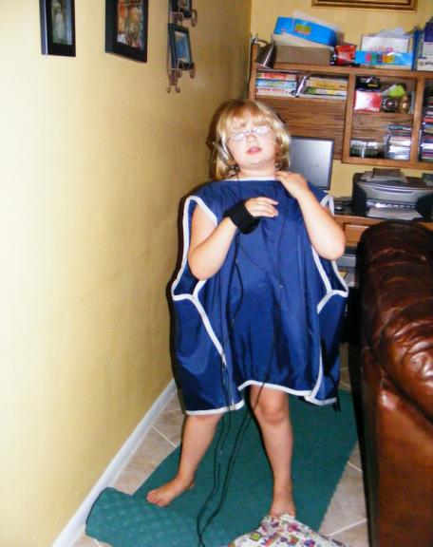
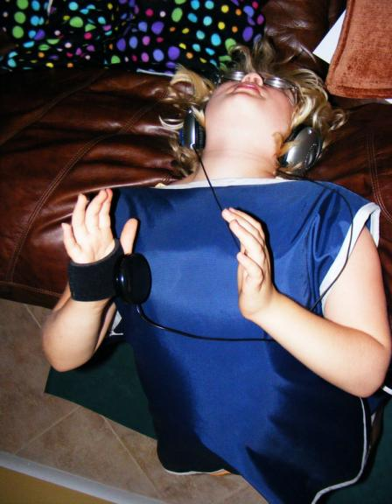
Extreme IM! Child led selection of weighted vest and positioning.

Slide 37
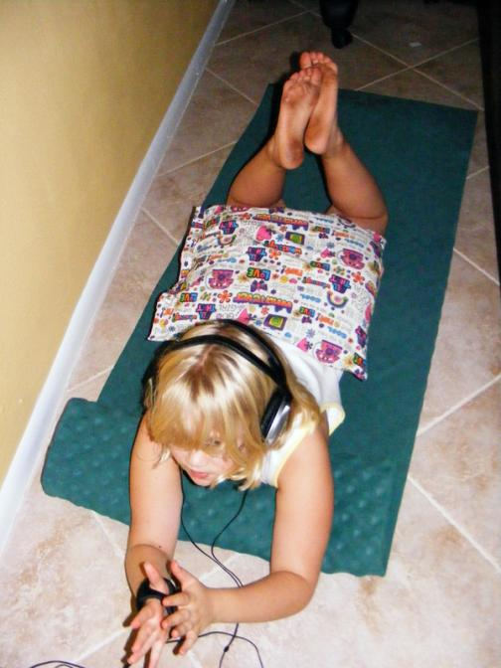
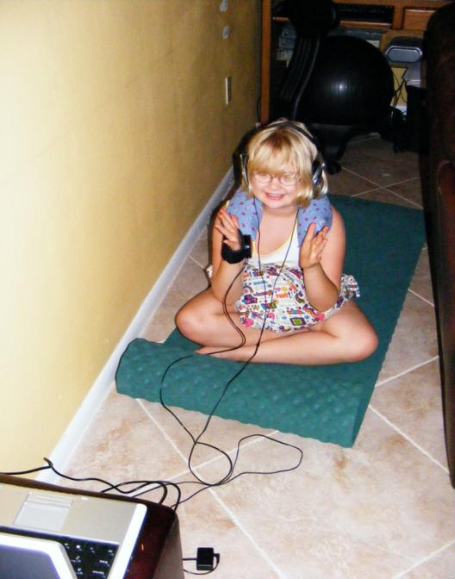
Alternate between challenging physical and sensory parameters

Slide 38
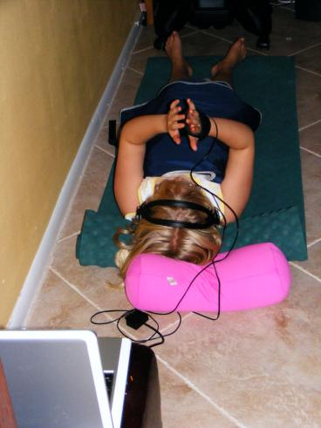
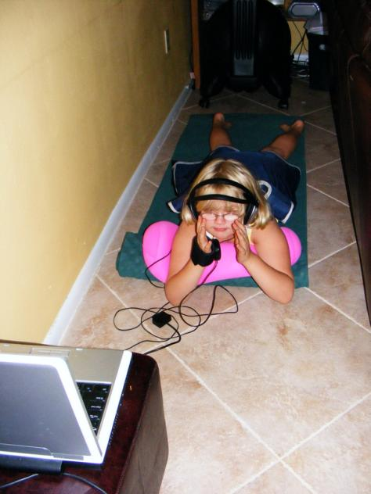
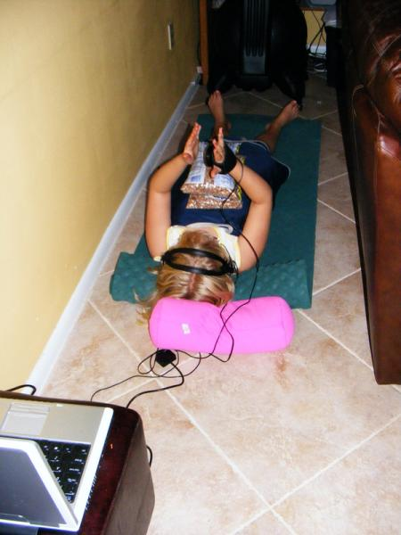
Allow children a choice of comfort measures, with and against gravity

Slide 39
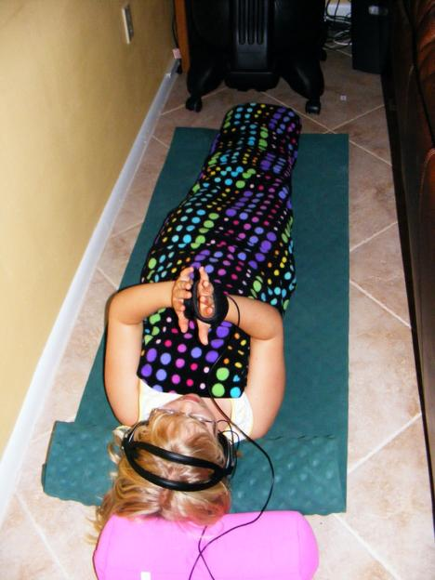
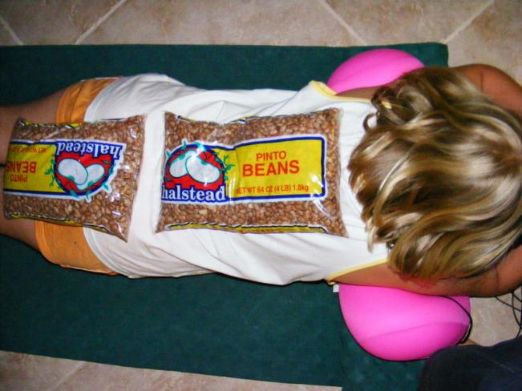
Deep Pressure is calming to the central nervous system

Slide 40
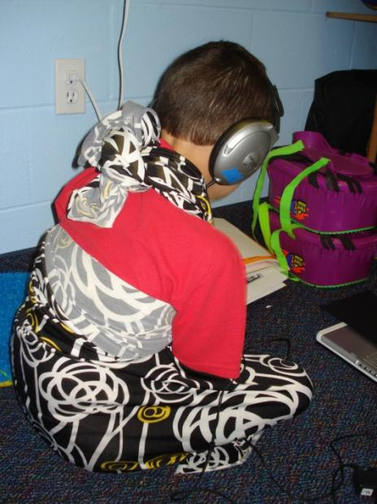
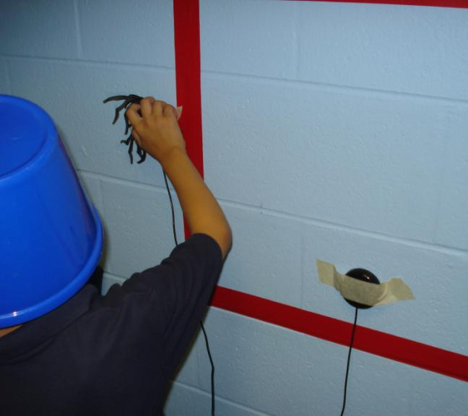
Homemade “Snuggy” and yes, a bucket on the child’s head for proprioception challenge!

Slide 41
Blending Sensory Activities with IM tasks
Movie: Slide 41 – blending sensory…
Notes:
Slide 40 – blending sensory activities.mp4

Slide 42
Blending Sports Interest with IM Activity
Movie: Slide 42 – blending sports…
Notes:
Slide 41 – blending sports interests.mp4

Slide 43
Turn Taking with Sensory Choices
Movie: Slide 43 – Turn taking.mp4
Notes:
Slide 42 – Turn taking.mp4

Slide 44

Review of Module 2 Learning Objectives
Modify tools for setting up physical environments and sensory environments
Examples of sensory modifications
Examples of setting up
physical environment

Slide 45


Slide 46
Module 2 Homework
Complete Module 2 Post-Test
Complete Module 2 Worksheet
Review resource sheet for Module 2

